Slide 1
TIME-TO-FAILURE PREDICTION (TTF)
Forecasting plane engine failure with sensors data
Lorenzo Suppa, Vito Perrucci and Tanguy Dugas du Villard

Slide 2
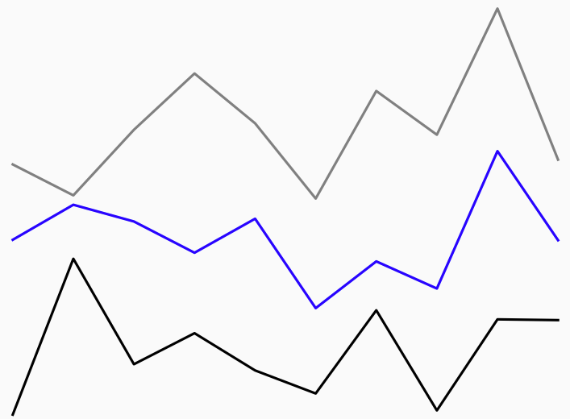
Goal: Predicting airplane’s engine failure before it happens
Current-time
Failure
Software
Sensor measures
RUL
Remaining Useful Life (RUL)
time

Slide 3




Objectives and Value Proposition:
Offer continuous maintenance assistance
Decrease components production
Decrease maintenance time and costs

Slide 4









Functional diagram:
C-MAPSS
DATASET
PREPROCESSING
REMAINING USEFUL LIFE
MODEL
POSTPROCESSING
THE SOFTWARE
ENGINE
SENSORS
Our work
MAINTENANCE TEAM
Real-life usage

Slide 5
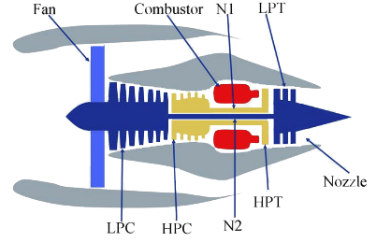

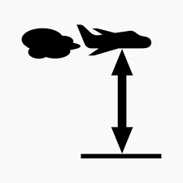

Challenges of the data
How to deal with different types of failure?
How to adapt forecasts to environment settings?
Air temperature Altitude Speed

Slide 6
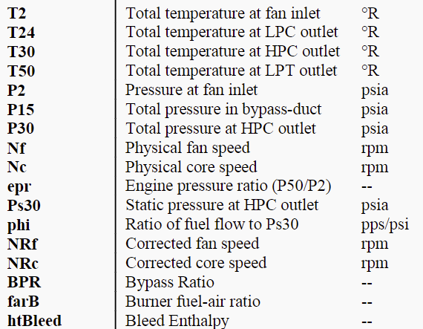
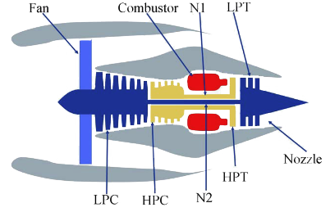
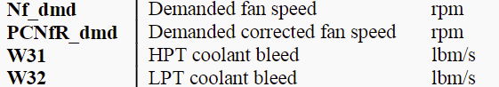
Research questions
Which are the most relevant
features to collect ?

Slide 7
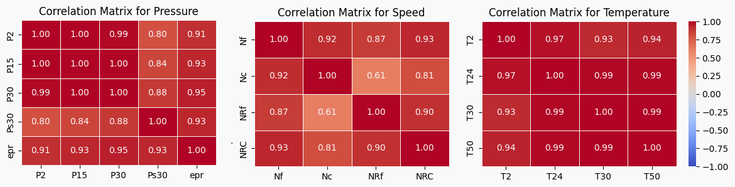
Research questions
Which are the most relevant features to collect ?
Correlation Matrices

Slide 8
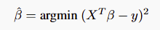

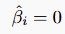


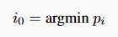
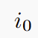
Research questions
Which are the most relevant features to collect ?
Backward Elimination
Backward Elimination
Linear regression
Hypothesis tests:
p-values of the test:
Worst feature:
If > 0.1: Remove from X and go back to 1.
Else: stop the algorithm
RUL y
Features X
Removed features

Slide 9
Research questions
Which are the most relevant features to collect ?
Highly correlated temperatures
Highly correlated pressures
Highly correlated speeds
Not enough informative
21 features => 13 features

Slide 10
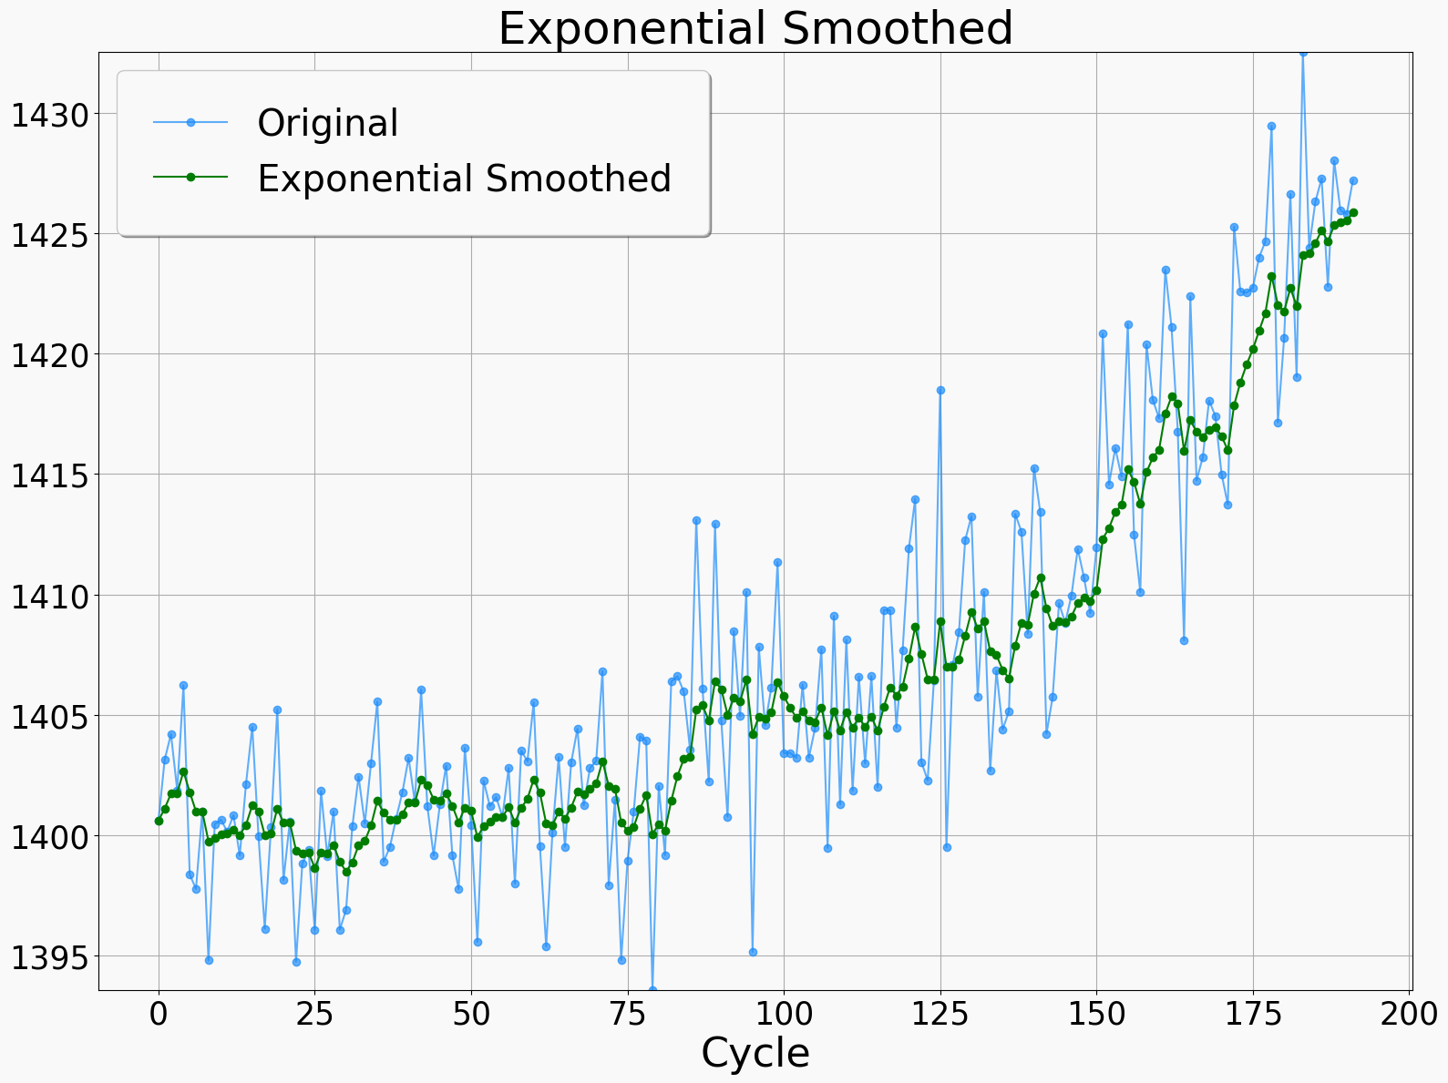
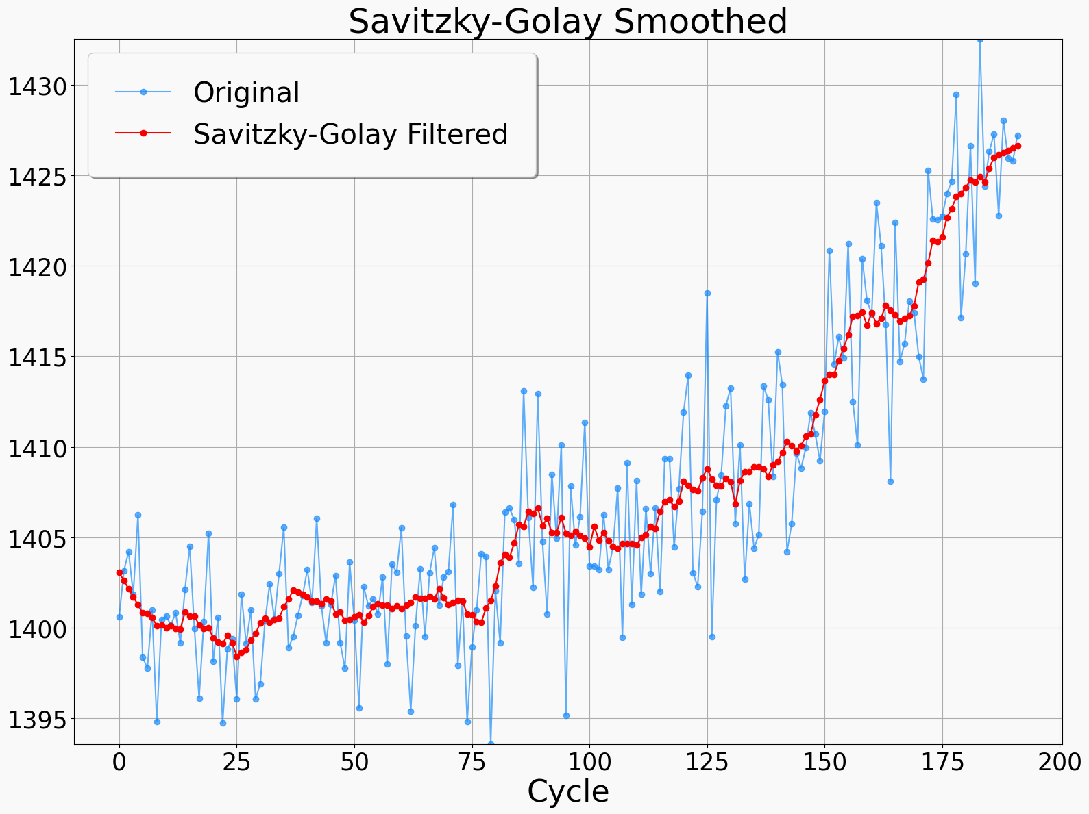
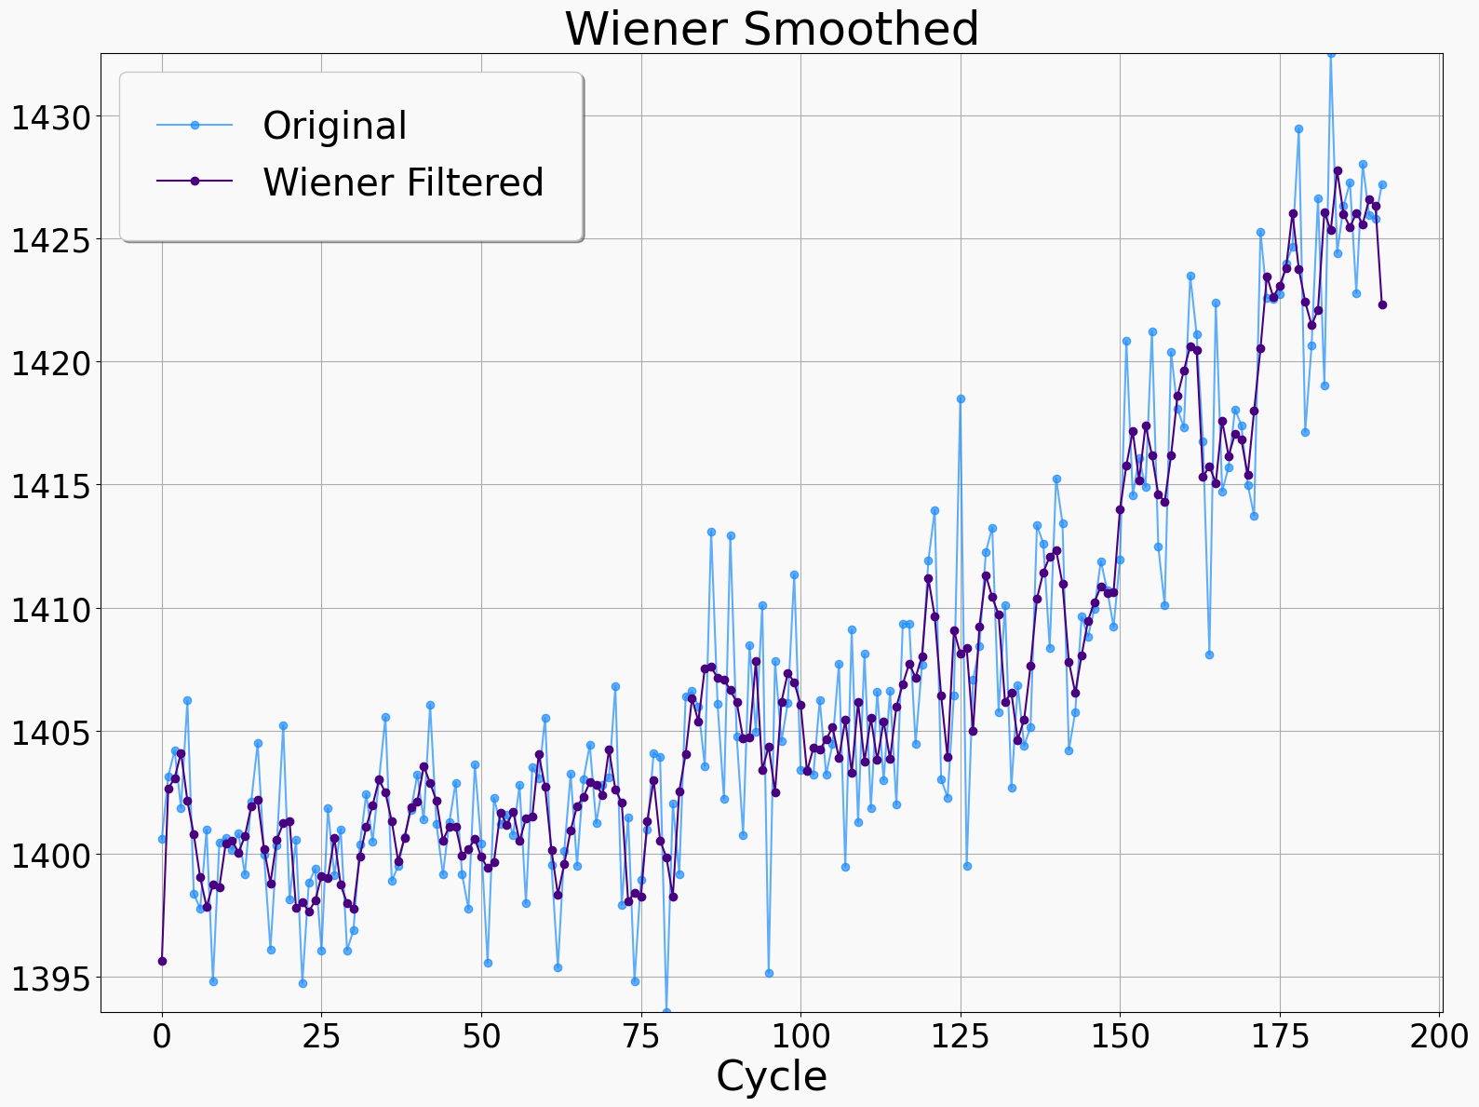
Research questions
How can sensor noise in time-series data be effectively mitigated to improve the accuracy in our RUL predictions?
Notes:
PERFECT poropopopò

Slide 11
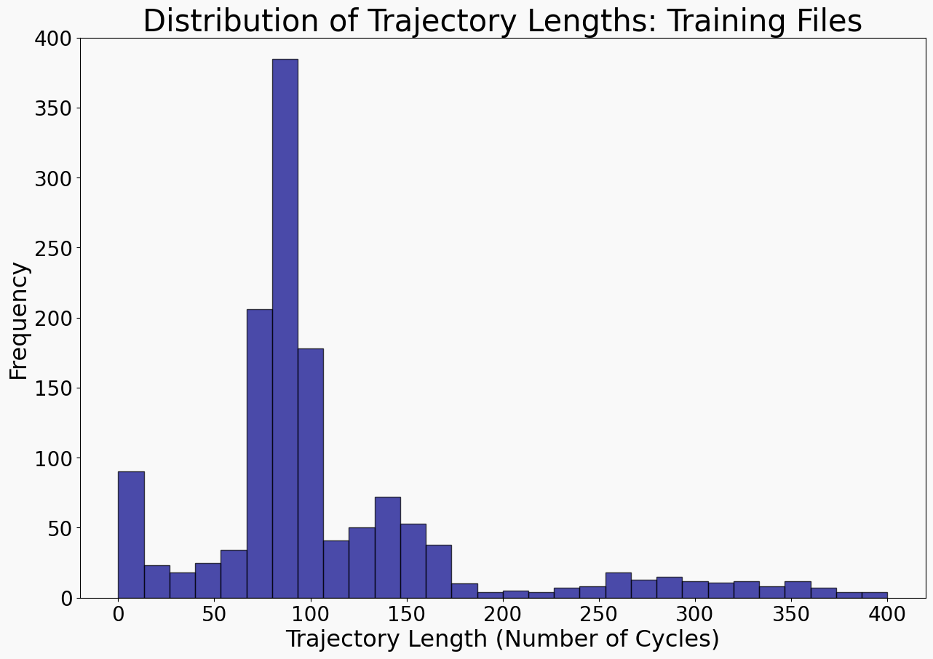
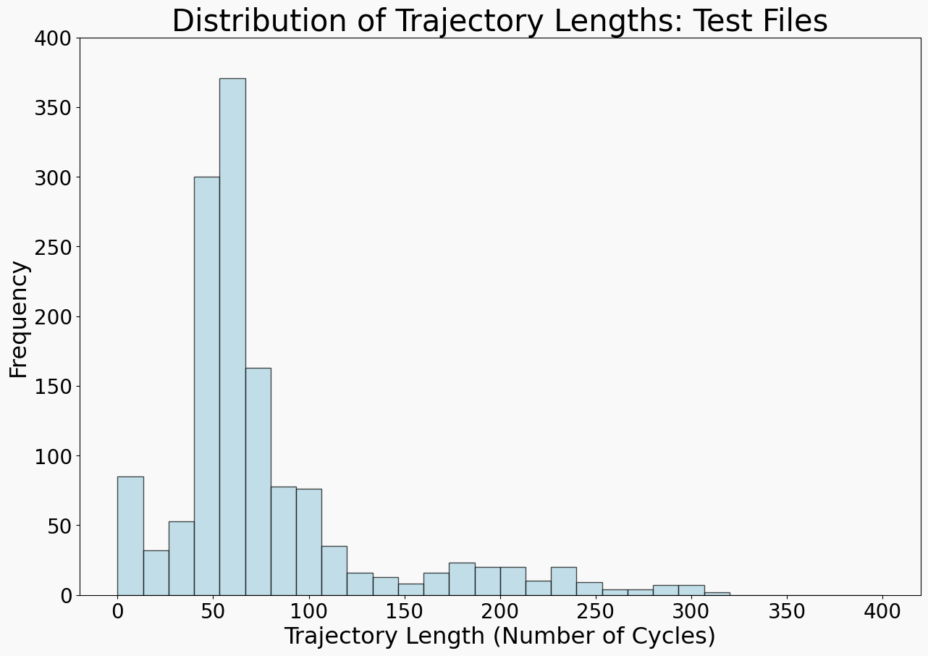
Research questions
How can we deal with trajectories having different length ?

Slide 12

Research questions
How can we deal with trajectories having different length ?
Windows
windows end cycles
reconstructed dataset
DATASET
windows data
same size: W = 19

Slide 13
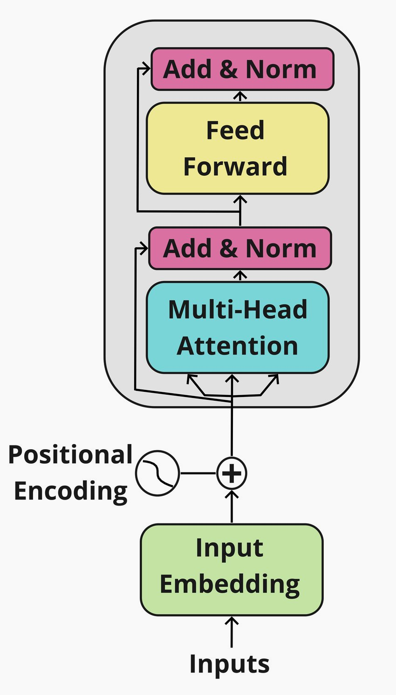
EncoderRegressor
Key changes and chosen hyperparameters:
• Embedding & Positional Encoding: – Positional encoding can be learnable.
• Within Transformer Encoder Layers: – Batch normalization over Layer normalization to effectively manage possible outliers
• Output Head: – Pre-training: Maps high-dimensional representations back to original input dimension for reconstruction. – Regression: Applies mean pooling followed by a fully-connected head for single RUL prediction.
• Hyperparameters: – Batch size=128, embedding_dim=256, num_heads=16, num_Encoder_layers=4

Slide 14
2-Phase Training: Pre-Training
Reconstructed Window
Self-supervised input reconstruction
– Randomly mask approximately 15% of window’s values. Another layer at the end of the flow is added to maps the high-dimensional representations back to the original input dimension
– Objective: Reconstructing the original values at the masked position using MSE loss.
– Our intention: Make the model learn contextual and temporal dependencies with few training epochs.
Masked Window

Slide 15
2-Phase Training: Fine-Tuning
RUL
2. Self-supervised RUL prediction
– Transfer pre-trained weights to a regression model with a new head that aggregates the sequence via mean pooling and maps the representation to a single RUL prediction.
– Objective: Fine-tune the model on the regression task predicting RUL for each window.
– Our intention: Leverage the robust features learned during pre-training to efficiently adapt the model for precise RUL estimation with minimal additional training epochs.
Window

Slide 16
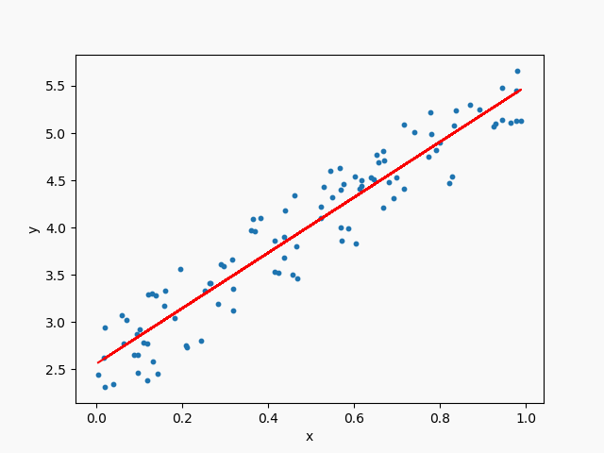
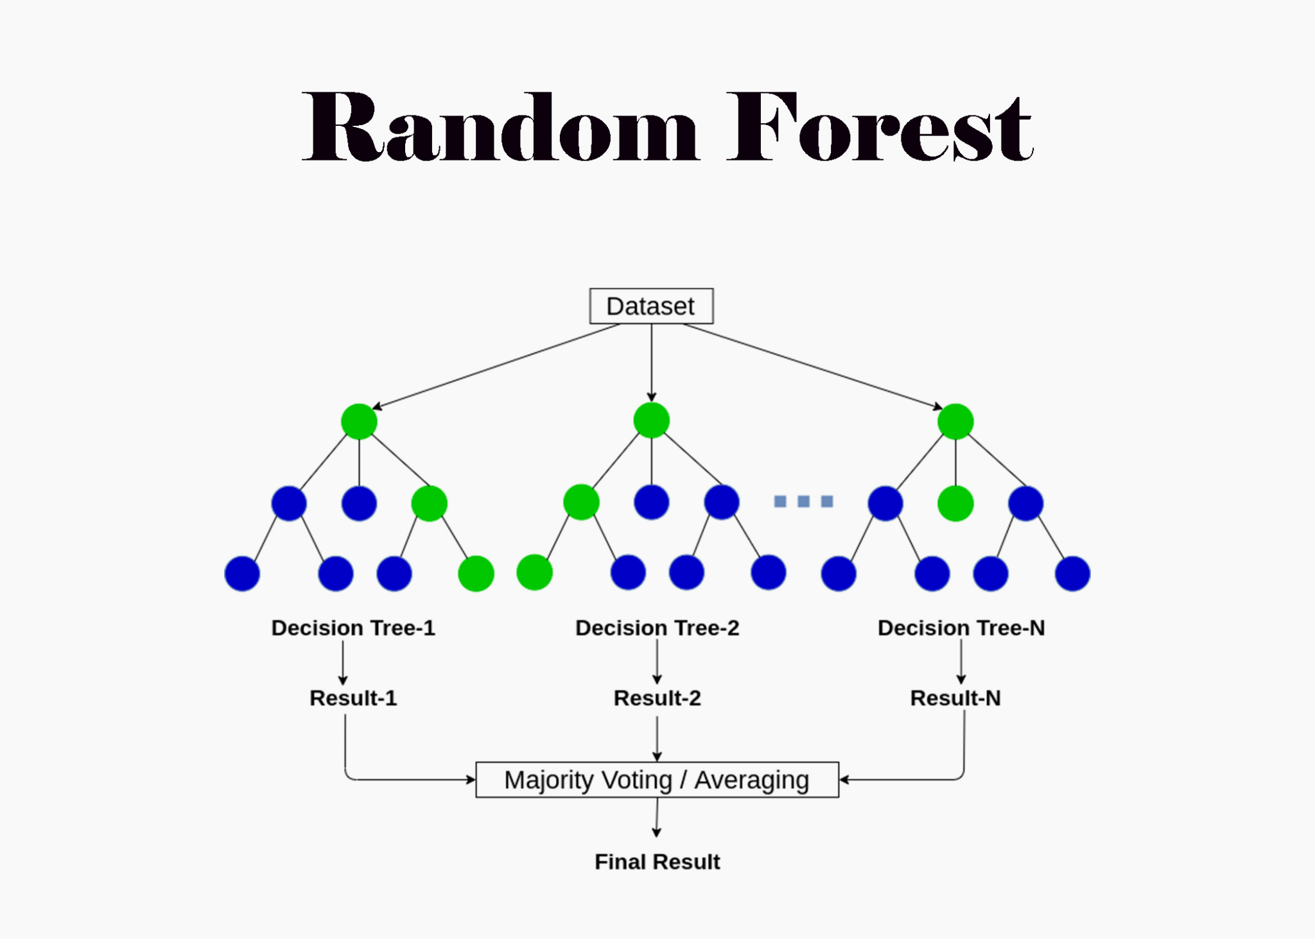
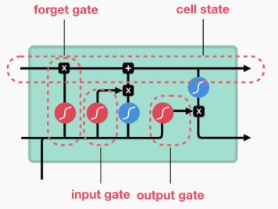
Baseline models
Other models have been trained on the same dataset, with the same preprocessing steps, in order to compare their performance with our EncoderRegressor.
Results and comparisons will be further discussed.
Linear regression
Random forest
Long Short-Term Memory

Slide 17
Research questions
How can we deal with trajectories having different length?
Fixed window size creation
Window-level
Predictions
Trajectory-level
Predictions
Trajectories
Windows
Aggregation
MODEL
Windows ground truth
Trajectories ground truth

Slide 18
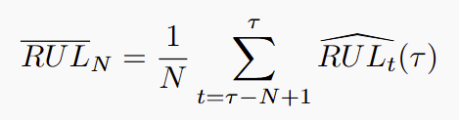
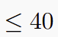
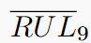
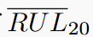
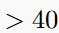
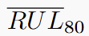
Research questions
How can we deal with trajectories having different length ?
Aggregation: Unweighted average over the last predictions
RUL (𝜏)
RUL (𝜏)
RUL (𝜏)
RUL (𝜏)
W
W+1
W+2
𝜏
First rough
estimation
Aggregation
RUL

Slide 19
Results
Window-level
Predictions
Trajectory-level
Predictions
Trajectories
Windows
Aggregation
MODEL
Windows ground truth
Trajectories ground truth

Slide 20


Results
Windows ground truth
Window-level
Predictions
Trajectories ground truth
Trajectory-level
Predictions
Aggregation
Window-level performance
Trajectory-level performance

Slide 21
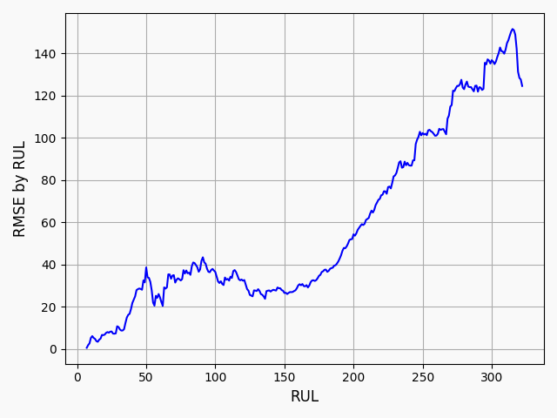
Window-Level Performance Analysis
the EncoderRegressor exhibits excellent window-level performance, consistently achieving lower RMSE values in low RUL scenarios crucial for early failure detection
Some metrics on RMSE:
Global RMSE : 41.47
<50 RUL RMSE: 18.15
<20 RUL RMSE: 5.05

Slide 22
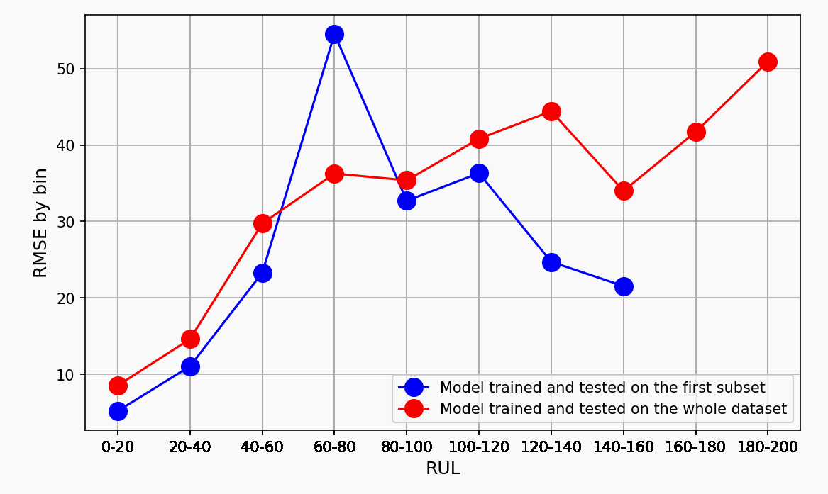
Trajectory-Level Performance Analysis
Aggregated forecasts reveal that while the model excels at predicting imminent failures with low RMSE, its error increases gradually as the RUL rises.
On first subset
(1 failure type, 1 flight condition)
Global RMSE : 30.70
<20 RUL RMSE: 5.05
On whole dataset:
(2 failure types, 6 flight conditions)
Global RMSE : 35.20
<20 RUL RMSE: 8.56

Slide 23
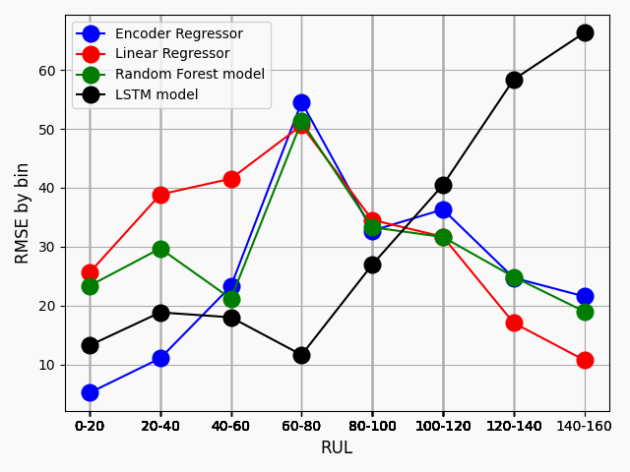
Comparison against Other Models
Encoder Regressor:
Global RMSE : 30.70
<20 RUL RMSE: 5.05
Linear Regressor:
Global RMSE : 33.92
<20 RUL RMSE: 25.59
Random Forest model:
Global RMSE : 32.47
<20 RUL RMSE: 23.36
LSTM model:
Global RMSE : 32.84
<20 RUL RMSE: 13.23

Slide 24
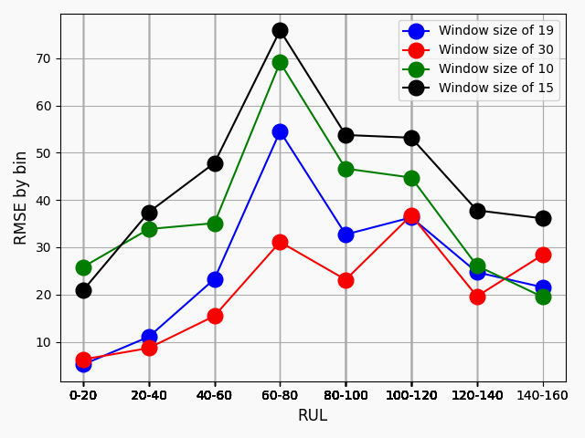
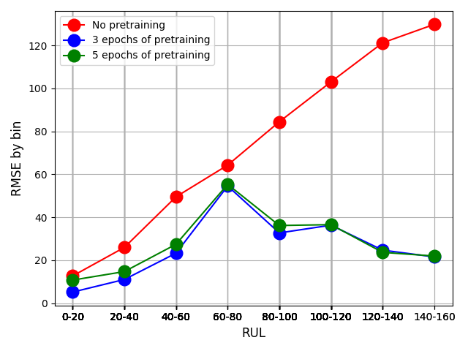
Impact of Window Size and Pretraining
Increasing the window size and the number of pretraining epochs appears to improve performance. However, excessive increases may lead to overfitting.
Windows size analysis
Pretraining analysis
here, the blu should be the 3 epochs

Slide 25
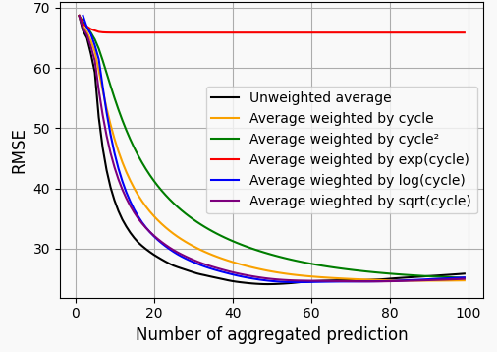
Impact of Aggregation Strategies
Splitting the trajectories by short-term and long-term failure cases, the optimal number of windows is dependent on the time remaining until failure
Notes:
the unweighted average consistently delivers the best overall performance in both scenarios.

Slide 26
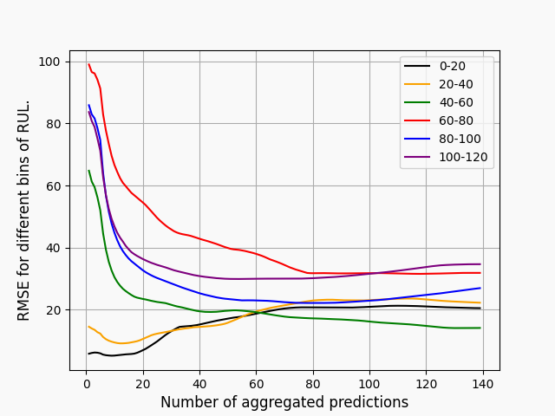
Number of Aggregated Windows
After selecting the unweighted average as the aggregation strategy, we analyze the impact of the number of aggregated windows on the final prediction.
Unweighted Average Aggregation
On Trajectories with RUL < 40:
Best Number of predictions: 9
On Trajectories with RUL > 40:
Best Number of predictions: 80

Slide 27

Further extension: Classifying risk of failure
Current-time
Failure
High
Medium
Low
Software
RUL
Risk level
Sensor measures
Need to define High, Medium and Low risks, based on:
RUL
Flight condition
Failure type
Engine type
Specific requirements and regulations
…
=> Inputs from the clients
time

Slide 28
Any question ?
Tanguy Dugas du Villard
Vito Perrucci
Lorenzo Suppa

